Slide 1
Methods I Lab Lecture 6

Slide 2
Reminders
Homework 3 is due at 5 pm today.
Exam is online and set to be opened Thursday.
Multiple choice, short answer
Won’t require use of SAS, R, or SPSS
Exam will open on Moodle at 6am on 9/28 and close at 2am on 9/29.
Once you open the exam, you’ll have 2 hours to complete it.
Open book, open notes, open internet.
Absolutely no communicating with anyone else during the exam about it!

Slide 3
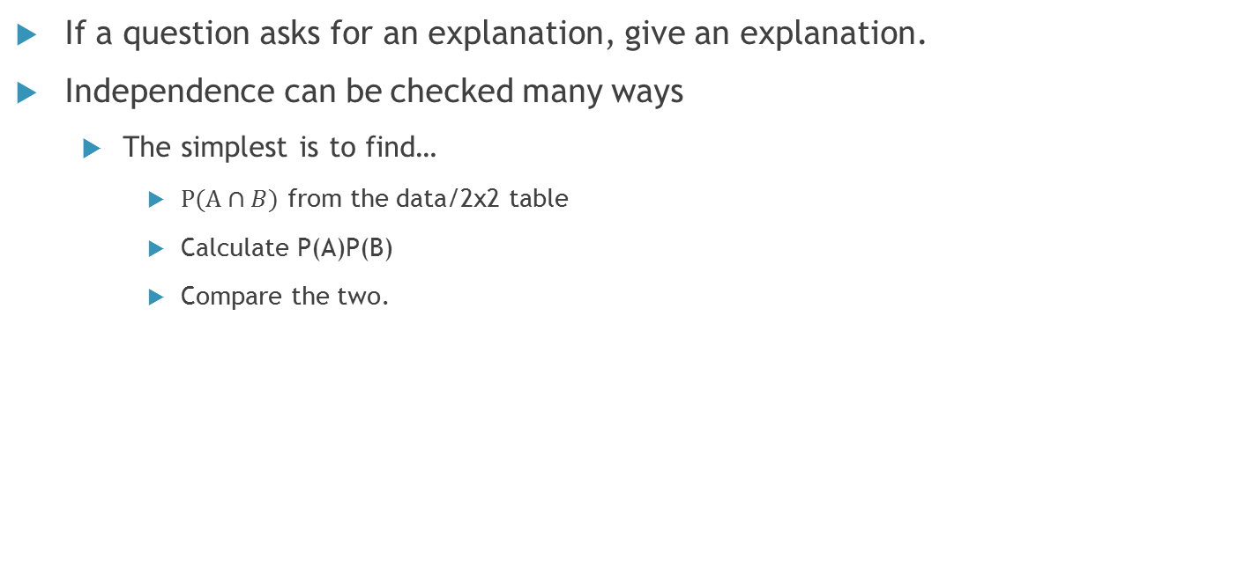
Notes from HW 2
If a question asks for an explanation, give an explanation.
Independence can be checked many ways
The simplest is to find…
$P(A∩B)$ from the data/2x2 table
Calculate P(A)P(B)
Compare the two.

Slide 4
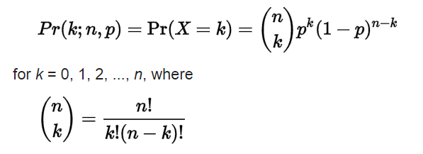
Binomial Distribution
Used for Binary outcomes
i.e. Ready for the test/Not ready for the test, Hungry/Not Hungry, Bored/Not Bored etc.
The distribution takes the form
N is the total number of “trials”
K is the number of “successes”
When n=1, a special case called the Bernoulli Distribution occurs.

Slide 5
Binomial Example
Instead of using SPSS, use the applet suggested by Dr. Nietert.
http://homepage.divms.uiowa.edu/~mbognar/applets/bin.html
Ex. Assume that the success rate for treatment A for curing disease B is .75 and that the treatment is given to 50 patients.
1. What is the probability that more than 25 patients have successful treatment?
2. What is the probability that between 25 and 35 patients have successful treatment?
3. What is the probability that between 25 and 35 patients don’t have successful treatment?

Slide 6
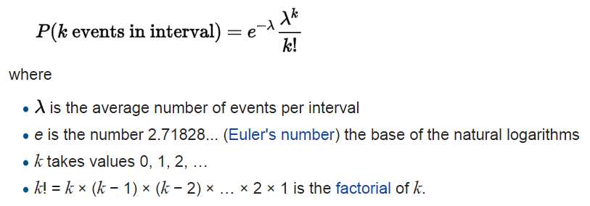

Poisson Distribution
Used to model counts of events.
The Pmf looks like
$λ$ is both the expected value and variance of the distribution.

Slide 7
Poisson Example
Instead of using SPSS, use the applet suggested by Dr. Nietert.
http://homepage.divms.uiowa.edu/~mbognar/applets/pois.html
Ex. Assume that the average number of cups of coffee consumed by a graduate student per day is 3.
4. What is the probability that a graduate student drinks 2 cups of coffee in a day?
5. What is the probability that graduate student drinks less than 3 cups of coffee in a day?
6. What is the probability that a graduate student drinks 15 cups of coffee in a week?

Slide 8
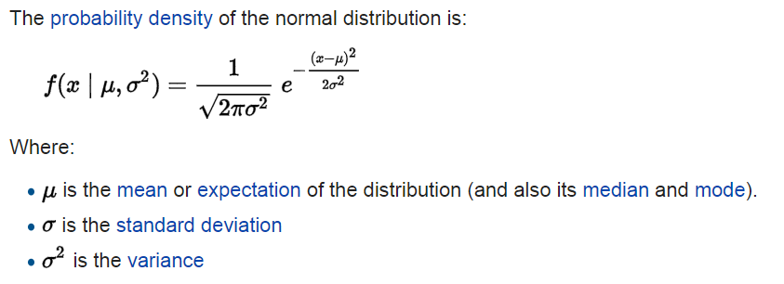
Normal Distribution
Used for almost anything that is continuous and some things that aren’t.
Ex. Age (usually recorded as a discrete variable)
The Pdf looks like
When the mean is 0 and the variance is 1, a special case called the standard normal arises.

Slide 9
Normal Example
Instead of using SPSS, use the applet suggested by Dr. Nietert.
http://homepage.stat.uiowa.edu/~mbognar/applets/normal.html
Ex. Assume that the average grade on the Methods 1 exam is 85 with a standard deviation of 5.
7. What is the probability that a given student made a 95 on the exam?
8. What is the probability that a student passed the exam, i.e. made above a 75?
9. What is the Z score for a student who made a 99 on the exam?

Slide 10
Solutions
1. 1
2. .25
3. 0
4. .22
5. .65
6. .04
7. 0
8. .98
9. 2.8

